Slide 1


ITI1121A
LAB #10 – April 1, 2016
Friday 11:30 – 14:30
Professor: Nour El-Kadri
TA: Berk Soysal
bsoys096@uottawa.ca
Office Hour: Fridays 15:00 – 16:00
Office Location: SITE 5000D
Download this ppt. - http://uottawa.ml
2016 Winter Prepared by Berk Soysal for ITI1121A

Slide 2
Iterators
Often, you will want to cycle through the elements in a collection. For example, you might want to display each element or remove an element.
The easiest way to do this is to employ an iterator, which is an object that implements either the Iterator or the ListIterator interface.
2016 Winter Prepared by Berk Soysal for ITI1121A

Slide 3
Iterator vs. ListIterator
Iterator | ListIterator
Unidirectional (forward iteration) Has only next() | Bidirectional (forward and backward iteration) Has next() and previous()
Map, List, Set implemented Objects | List implemented Objects only
remove() only | add(), remove()
Cannot determine current position of the iterator | Can determine the current position of the iterator
2016 Winter Prepared by Berk Soysal for ITI1121A

Slide 4
Iterator Iterface Methods
The Iterator interface specifies 3 methods:
boolean hasNext()
//returns true if this iteration has more elements
E next()
//returns the next element in this iteration
//pre: hastNext()
void remove()
/*Removes from the underlying collection the last element
returned by the iterator.
pre: This method can be called only once per call to next.
After calling, must call next again before calling remove
again.
*/
2016 Winter Prepared by Berk Soysal for ITI1121A

Slide 5
Iterators - Fence Analogy
Imagine a fence made up of fence posts and rail sections.
rails
fenceposts
2016 Winter Prepared by Berk Soysal for ITI1121A

Slide 6
Iterators - Fence Analogy
The iterator lives on the fence posts
The data in the collection are the rails
Iterator created at the far left post
As long as a rail exists to the right of the Iterator, hasNext() is true
iterator object
2016 Winter Prepared by Berk Soysal for ITI1121A

Slide 7
Iterators - Fence Analogy
ArrayList<String> names =new ArrayList<String>();
names.add(“Alex”);
names.add(“Liz”);
names.add(“Tim”);
names.add(“Jack”);
Iterator<String> it = names.iterator();
int i = 0;
iterator object
“Alex” “Liz” “Tim” “Jack”
2016 Winter Prepared by Berk Soysal for ITI1121A

Slide 8
Iterators - Fence Analogy
while( it.hasNext() ) {
i++;
System.out.println( it.next() );
}
// when i == 1, prints out Alex
first call to next moves iterator to next post and returns “Alex”
“Alex” “Liz” “Tim” “Jack”
2016 Winter Prepared by Berk Soysal for ITI1121A

Slide 9
Iterators - Fence Analogy
while( it.hasNext() ) {
i++;
System.out.println( it.next() );
}
// when i == 2, prints out Liz
“Alex” “Liz” “Tim” “Jack”
2016 Winter Prepared by Berk Soysal for ITI1121A

Slide 10
Iterators - Fence Analogy
while( it.hasNext() ) {
i++;
System.out.println( it.next() );
}
// when i == 3, prints out Tim
“Alex” “Liz” “Tim” “Jack”
2016 Winter Prepared by Berk Soysal for ITI1121A

Slide 11
Iterators - Fence Analogy
while( it.hasNext() ) {
i++;
System.out.println( it.next() );
}
// when i == 4, prints out Jack
“Alex” “Liz” “Tim” “Jack”
2016 Winter Prepared by Berk Soysal for ITI1121A

Slide 12
Iterators - Fence Analogy
while( it.hasNext() ) {
i++;
System.out.println( it.next() );
}
// while loop stops since call to hasNext returns false
“Alex” “Liz” “Tim” “Jack”
2016 Winter Prepared by Berk Soysal for ITI1121A

Slide 13
Remove( ) method
An Iterator can be used to remove things from the Collection
Can only be called once per call to next()
public void removeWordsOfLength(int len) {
Iterator<String> it = myList.iterator();
while( it.hasNext() ) { String temp = it.next();
if(temp.length() == len) it.remove();
}
}
// myList = [“dogs”, “cat”, “hats”, “bikes”]
// resulting list after removeWordsOfLength(3) ?
2016 Winter Prepared by Berk Soysal for ITI1121A

Slide 14
Nested Classes
In Java, just like methods, variables of a class too can have another class as its member. Writing a class within another is allowed in Java.
The class written within is called the nested class, and the class that holds the inner class is called the outer class.
class OuterClass{
class InnerClass{
}
}
Inner classes are a security mechanism in Java.
2016 Winter Prepared by Berk Soysal for ITI1121A

Slide 15
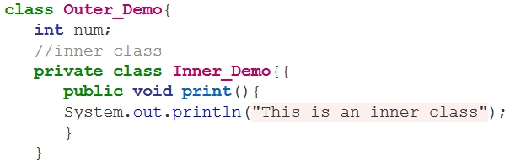
Nested Classes
We know a regular class cannot be associated with the access modifier private, but if we have the class as a member of other class, then the inner class can be made private.
2016 Winter Prepared by Berk Soysal for ITI1121A

Slide 16

Part 1.1- BitList
(20 mins)
You are provided an almost complete implementation of a class. Complete the implementation of the class BitList.
public BitList( String s ); creates a list of bits representing the input string s. The given string, s, must be a string of 0s and 1s, otherwise the constructor must throw an exception of type IllegalArgumentException.
This constructor initializes the new BitList instance to represent the value in the string. Each character in the string represents one bit of the list, with the rightmost character in the string being the low order bit. For example, given the string “1010111” the constructor should initialize the new BitList to include this list of bits:
-> 1 -> 1 -> 1 -> 0 -> 1 -> 0 -> 1
2016 Winter Prepared by Berk Soysal for ITI1121A

Slide 17
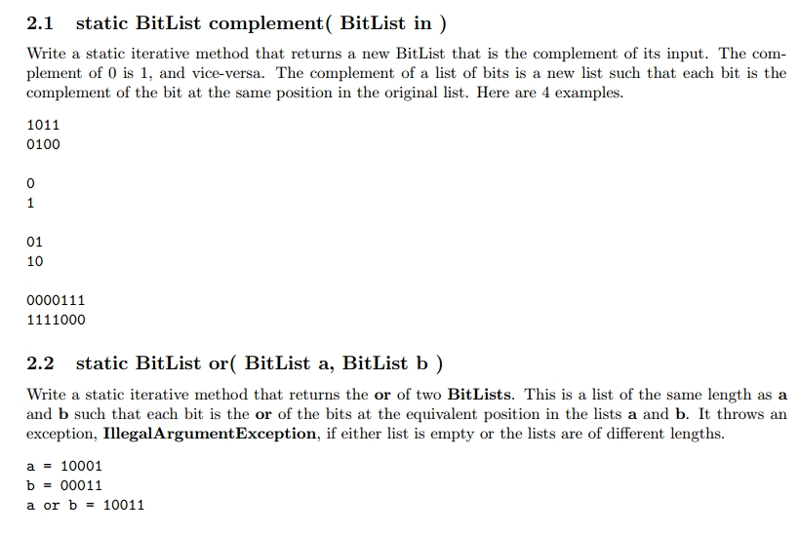
Part 1.2- Iterative (30 mins)
Use the class called Iterative. Implement the methods below. Your solutions must be iterative (i.e. uses iterators).
2016 Winter Prepared by Berk Soysal for ITI1121A

Slide 18

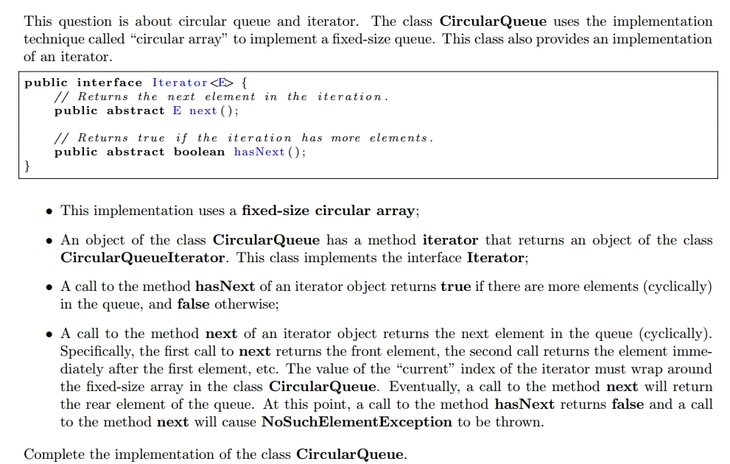
Part 2- CircularQueue (20 mins)
2016 Winter Prepared by Berk Soysal for ITI1121A

Slide 19
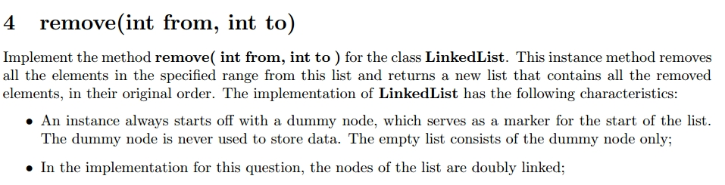
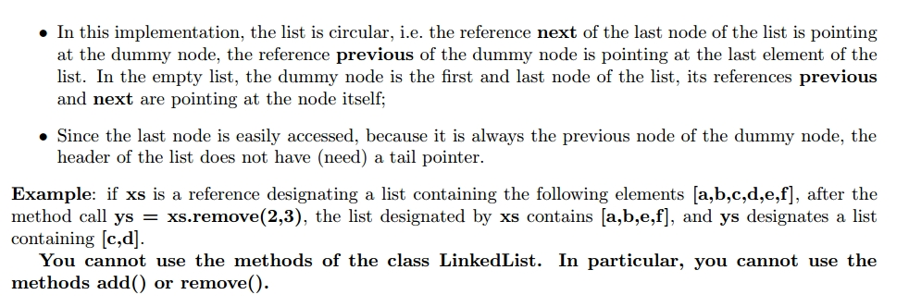
Part 3 - LinkedList
(Let’s do it together)
2016 Winter Prepared by Berk Soysal for ITI1121A

Slide 20
A new collection: Map
Map: an unordered collection that associates a
collection of element values with a set of keys so
that elements they can be found very quickly (O(1)!)
Each key can appear at most once (no duplicate keys)
A key maps to at most one value
the main operations:
put(key, value) "Map this key to that value."
get(key) "What value, if any, does this key map to?"
maps are also called:
hashes or hash tables
dictionaries
associative arrays
2016 Winter Prepared by Berk Soysal for ITI1121A

Slide 21
Java's Map interface
public interface Map { Object put(Object key, Object value); Object get(Object key); Object remove(Object key); boolean containsKey(Object key); boolean containsValue(Object value); int size(); boolean isEmpty(); void putAll(Map map); void clear(); Set keySet(); Collection values();
}
Basic ops
Bulk ops
Collection
views
2016 Winter Prepared by Berk Soysal for ITI1121A

Slide 22
Map implementations in Java
Map is an interface; you can't say new Map()
There are two implementations:
java.util.HashMap is best for most purposes
Preferred:
Map<Key,Value> m = new HashMap<Key,Value> ();
Not:
HashMap<Key,Value> m = new HashMap<Key,Value> ();
2016 Winter Prepared by Berk Soysal for ITI1121A

Slide 23
HashMap example
HashMap grades
Map<String,String> m = new HashMap<String,String> ();
grades.put("Martin", "A");
grades.put("Nelson", "F");
grades.put(“Alex", "B");
// What grade did they get?
System.out.println(
grades.get("Nelson"));
System.out.println(
grades.get("Martin"));
grades.put("Nelson", "W");
grades.remove("Martin");
System.out.println(
grades.get("Nelson"));
System.out.println(
grades.get("Martin"));
HashMapEntry
HashMap
"Martin"
"A"
0
HashMapEntry
2
"Nelson"
"F"
HashMapEntry
5
“Alex"
"B"
2016 Winter Prepared by Berk Soysal for ITI1121A

Slide 24
Map example
public class Example {
public static void main(String[] args){
Map m = new HashMap();
m.put("Newton", new Integer(1642));
m.put("Darwin", new Integer(1809));
System.out.println(m);
}
}
Output:
{Darwin=1809, Newton=1642}
2016 Winter Prepared by Berk Soysal for ITI1121A

Slide 25
Some Map methods in detail
public Object get(Object key)
returns the value at the specified key, or null if the key is not in the map (constant time)
public boolean containsKey(Object key)
returns true if the map contains a mapping for the specified key (constant time)
public boolean containsValue(Object val)//don’t use this
returns true if the map contains the specified object as a value
this method is not constant-time O(1) ... why not?
2016 Winter Prepared by Berk Soysal for ITI1121A

Slide 26
Collection views
A map itself is not regarded as a collection
Map does not implement Collection interface
although, in theory, it could be seen as a collection of pairs, or a relation in discrete math terminology
Instead collection views of a map may be obtained
Set of its keys
Collection of its values (not a set... why?)
2016 Winter Prepared by Berk Soysal for ITI1121A

Slide 27
Iterators and Maps
Map interface has no iterator method; you can’t get an Iterator directly
must first call either
keySet() returns a Set of all the keys in this Map
values() returns a Collection of all the values in this Map
then call iterator() on the key set or values
Examples: Iterator keyItr = grades.keySet().iterator(); Iterator elementItr = grades.values().iterator();
If you really want the keys or element values in a more familiar collection such as an ArrayList, use the ArrayList constructor that takes a Collection as its argument ArrayList elements = new ArrayList(grades.values());
2016 Winter Prepared by Berk Soysal for ITI1121A

Slide 28
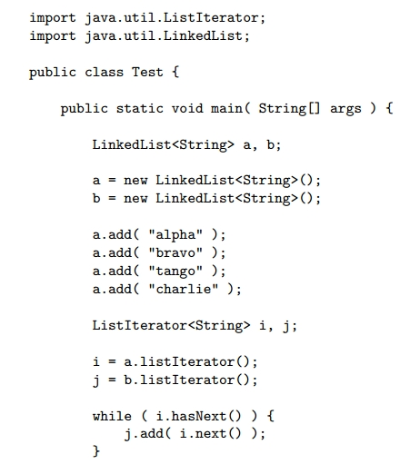
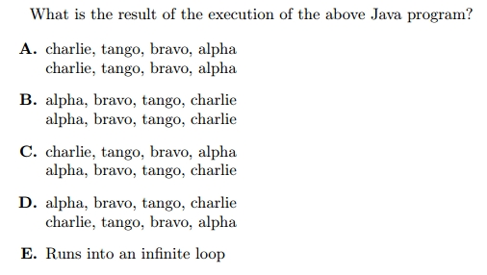
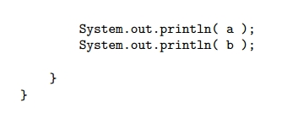
Quiz Question

